Slide 1
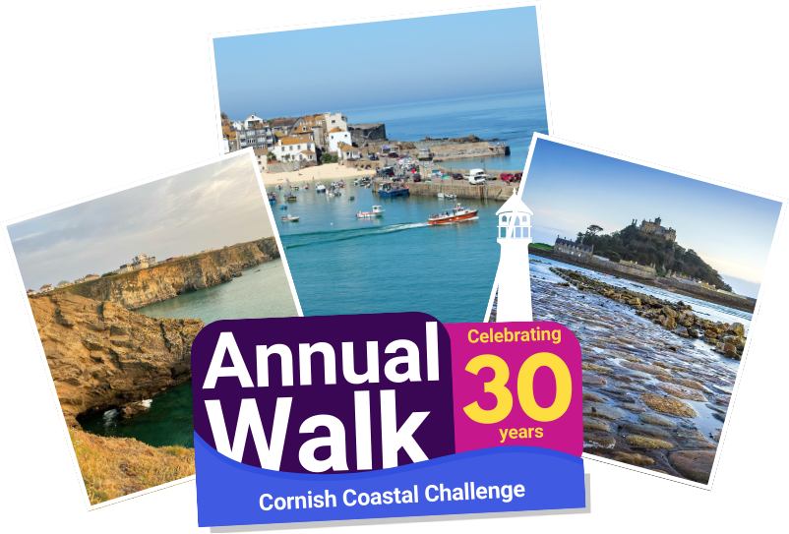



Slide 2
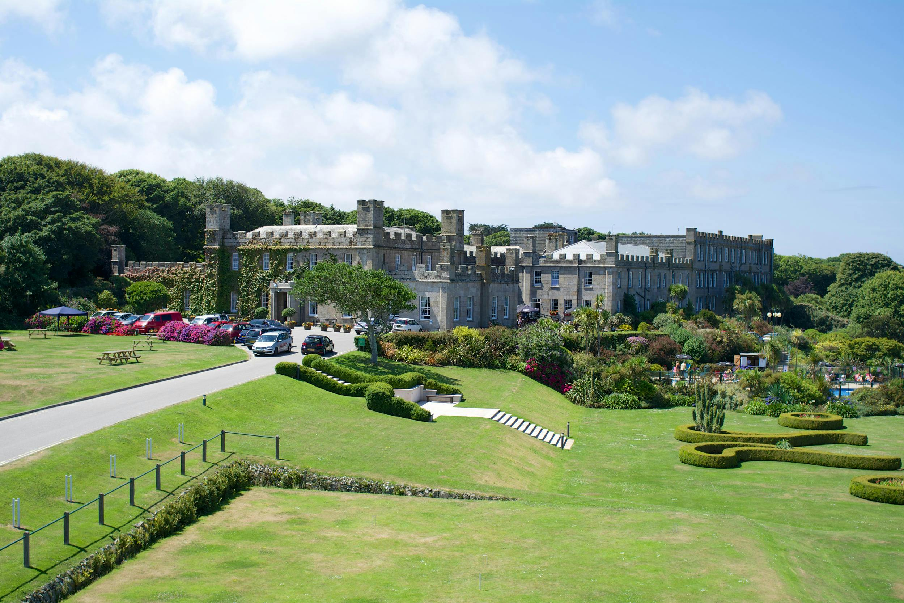

Tregenna Castle Resort
Your stay includes
Your room
Buffet Breakfast
Packed Lunch
3 course Dinner
Designated area to wash your boots before entering the resort

Slide 3
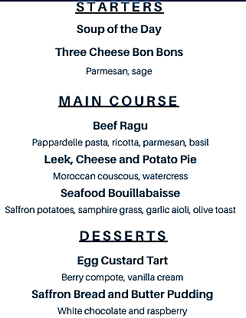
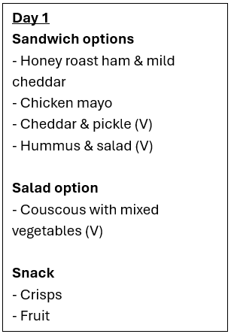
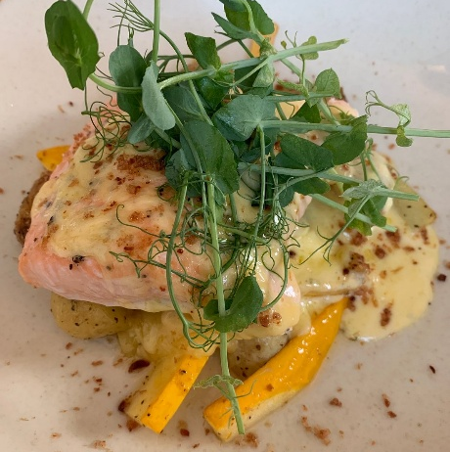
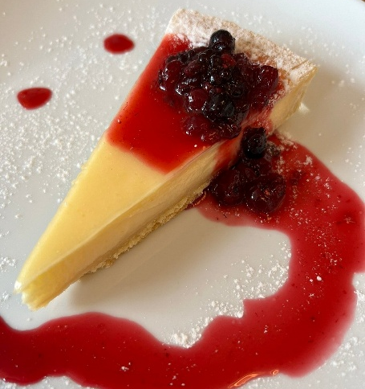
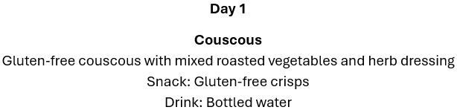
Breakfast, Lunch & Dinner
Breakfast- Hot Buffet Breakfast
Lunches provided by local caterer Zero Mile Kitchen
3 Course Dinner
We'll need to pre-order meals – watch out for an email from the Hospice

Slide 4
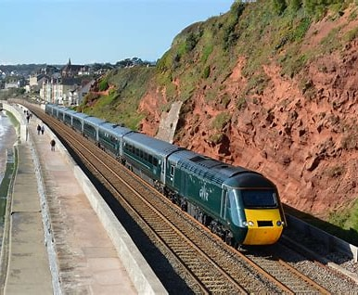
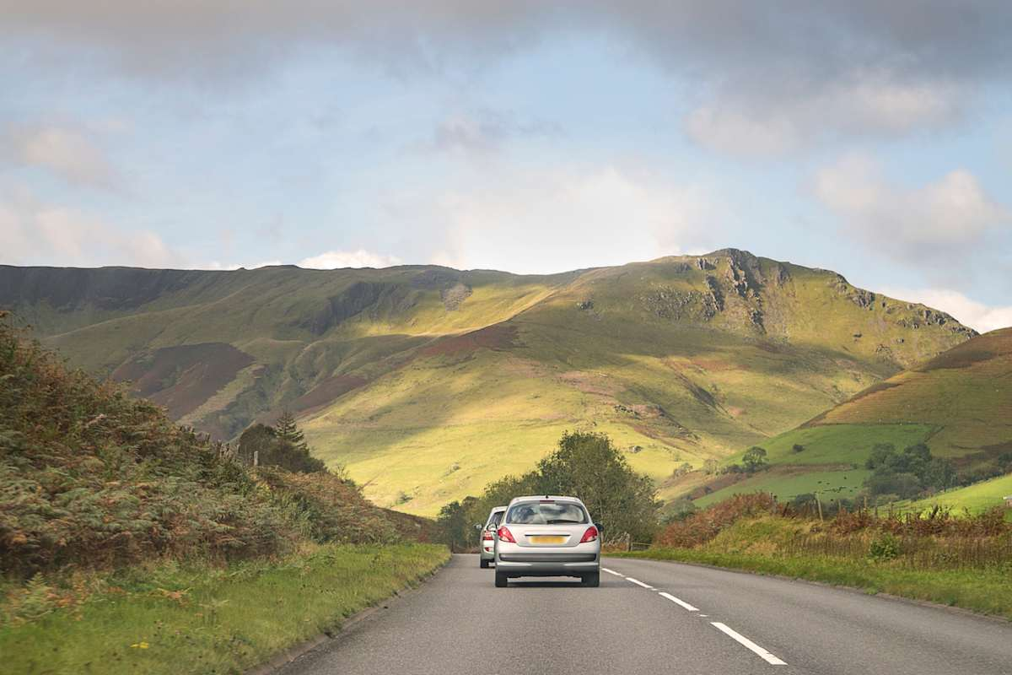
Day One – Travel Day
Train travellers
Take 10:02 from Paddington, arrives St Erth 14:59
Coach will take you from St Erth to Tregenna
For those who haven’t booked already
Book your own tickets, groups of 3-9 can get 1/3 reduction
Senior railcard gives 1/3 reduction
Car travellers
Make your own way to the Tregenna
All travellers
Please put a name label on the OUTSIDE of your suitcase
Please tell us which option you have chosen
At Dinner
MC outlines distances for the next day
You will be asked to choose your distance for the next day
Armbands handed out

Slide 5
How does the walk work?
Do you want a challenge?
Walk in small groups at your own speed
Choice of distance each day
Ultra– for the stronger, faster walker
Long– a full day walk at a similar pace to the rural training walks
Short – a shorter walk which can be accomplished at a more leisurely pace
You will be asked to choose your distance for the following day at dinner
Groups seem to naturally form – anyone can walk with anyone
Emergency phone numbers will be given out
Public loos not always available on the route (check walk notes)
Cut off times at penultimate check point
To ensure that the coach is not delayed
Walkers need to have left penultimate CP by specified time
Walk has been designed so that walkers should be able to complete their selected distance.

Slide 6
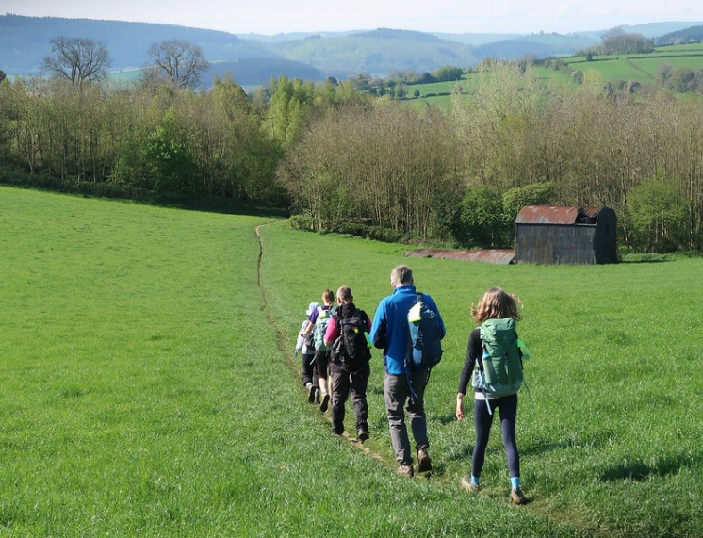
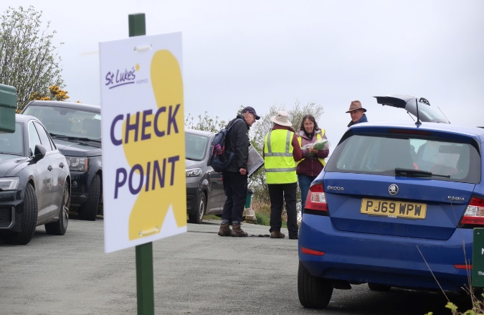
Checkpoints and Sweepers
Checkpoints
Sweepers
Every 4 -5 miles
Give your walker number to the checker and make sure they tick you off
Feel free to top up your water bottle
Stay at the back of the walk
All should be ticked off when they reach the checkpoint

Slide 7
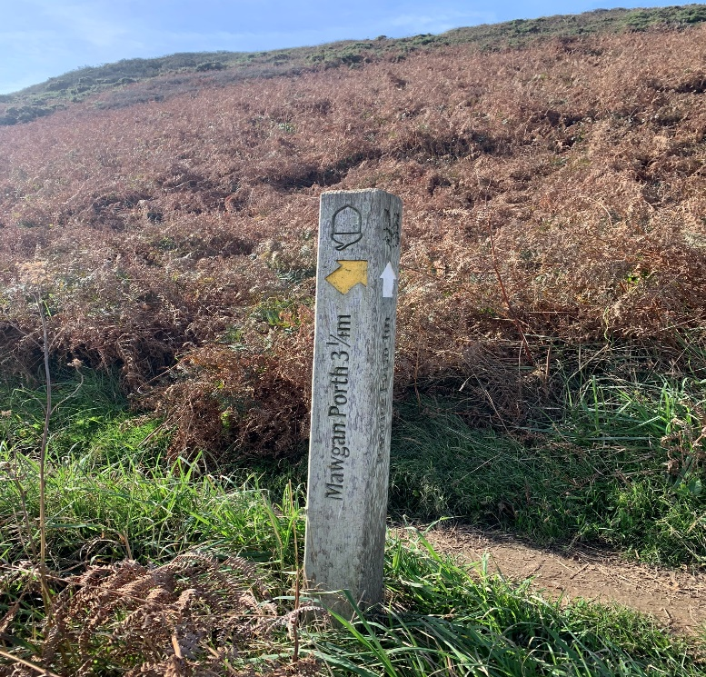
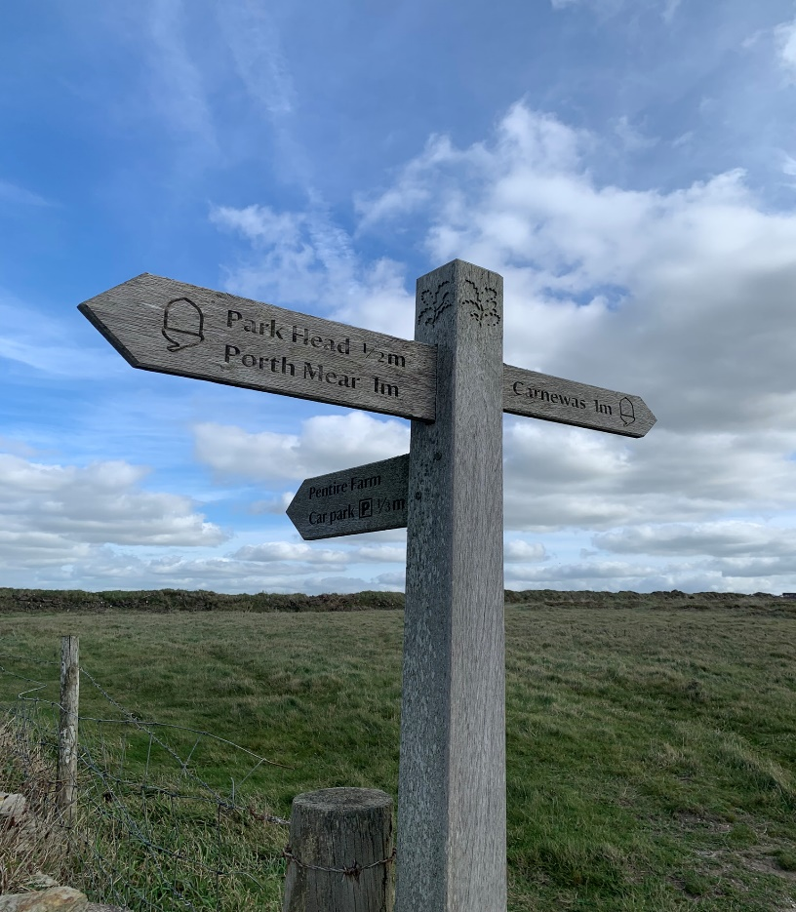
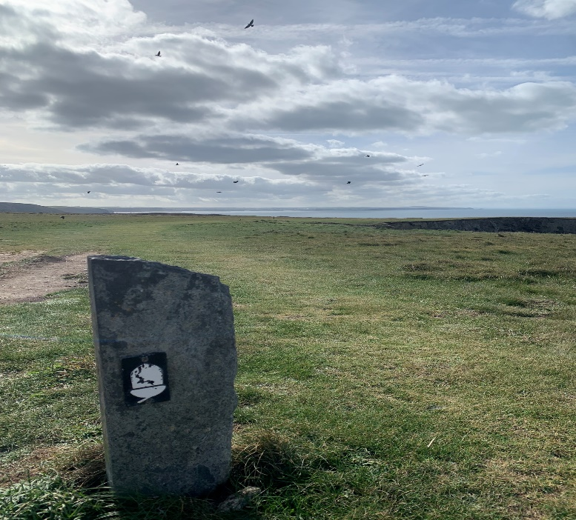
How do I know where to go?
Follow the signs
Waymarks
Finger posts
Maps
“Paper” maps
Follow the route on your phone
Walk Notes
A few extra instructions

Slide 8
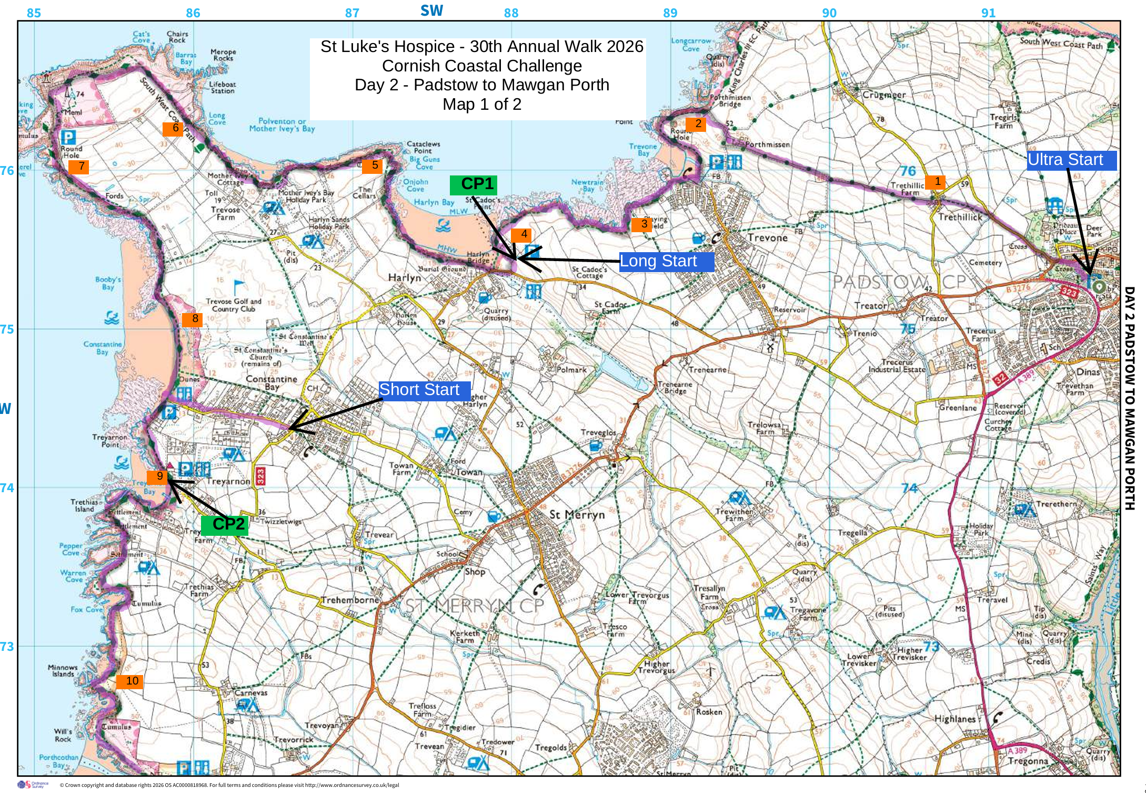
Example Map + Walk Note

Slide 9
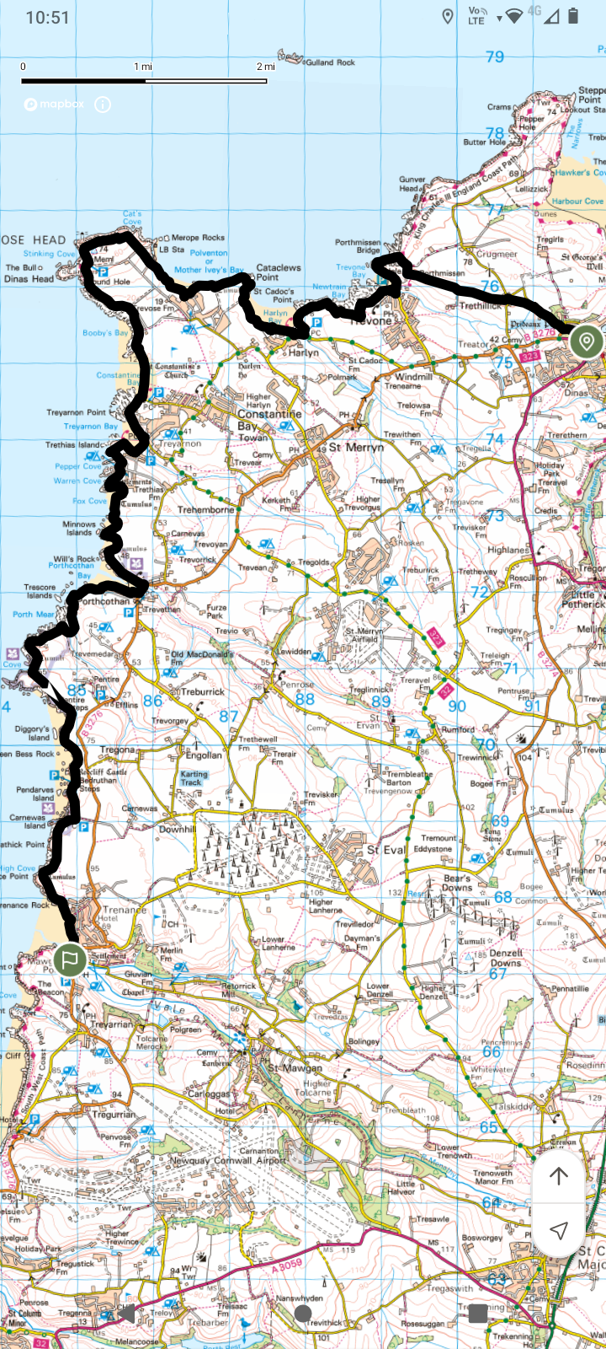
Digital Maps
For OS maps subscribers
Links to each day’s maps will be provided
Also, gpx files will be provided
Free apps currently used by members of the group to access a gpx file
Outdooractive
OsmAnd
GPX viewer
UK Map (iphone only)
OS maps app without subscription
Locate Me facility will provide a grid reference

Slide 10
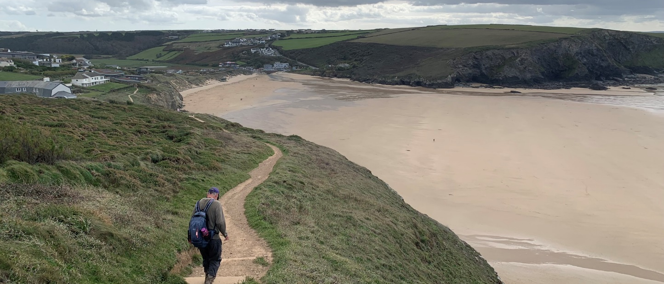
Day Two – Padstow to Mawgan Porth
Ready to walk at 08:25
Coach leaves at 08:30
Mixture of inland and Coastal Path
Some cliff top, some beach walking
Highlights include
Round Hole
Trevone Lighthouse
Cliff top walking
Finish at Merrymoor Inn, Mawgan Porth
Coach leaves 17:00 to return to Tregenna
Option | Start | Distance (miles)
Ultra | Padstow | 16.5
Long | Harlyn Bay | 12.5
Short | Constantine Bay | 8.5

Slide 11
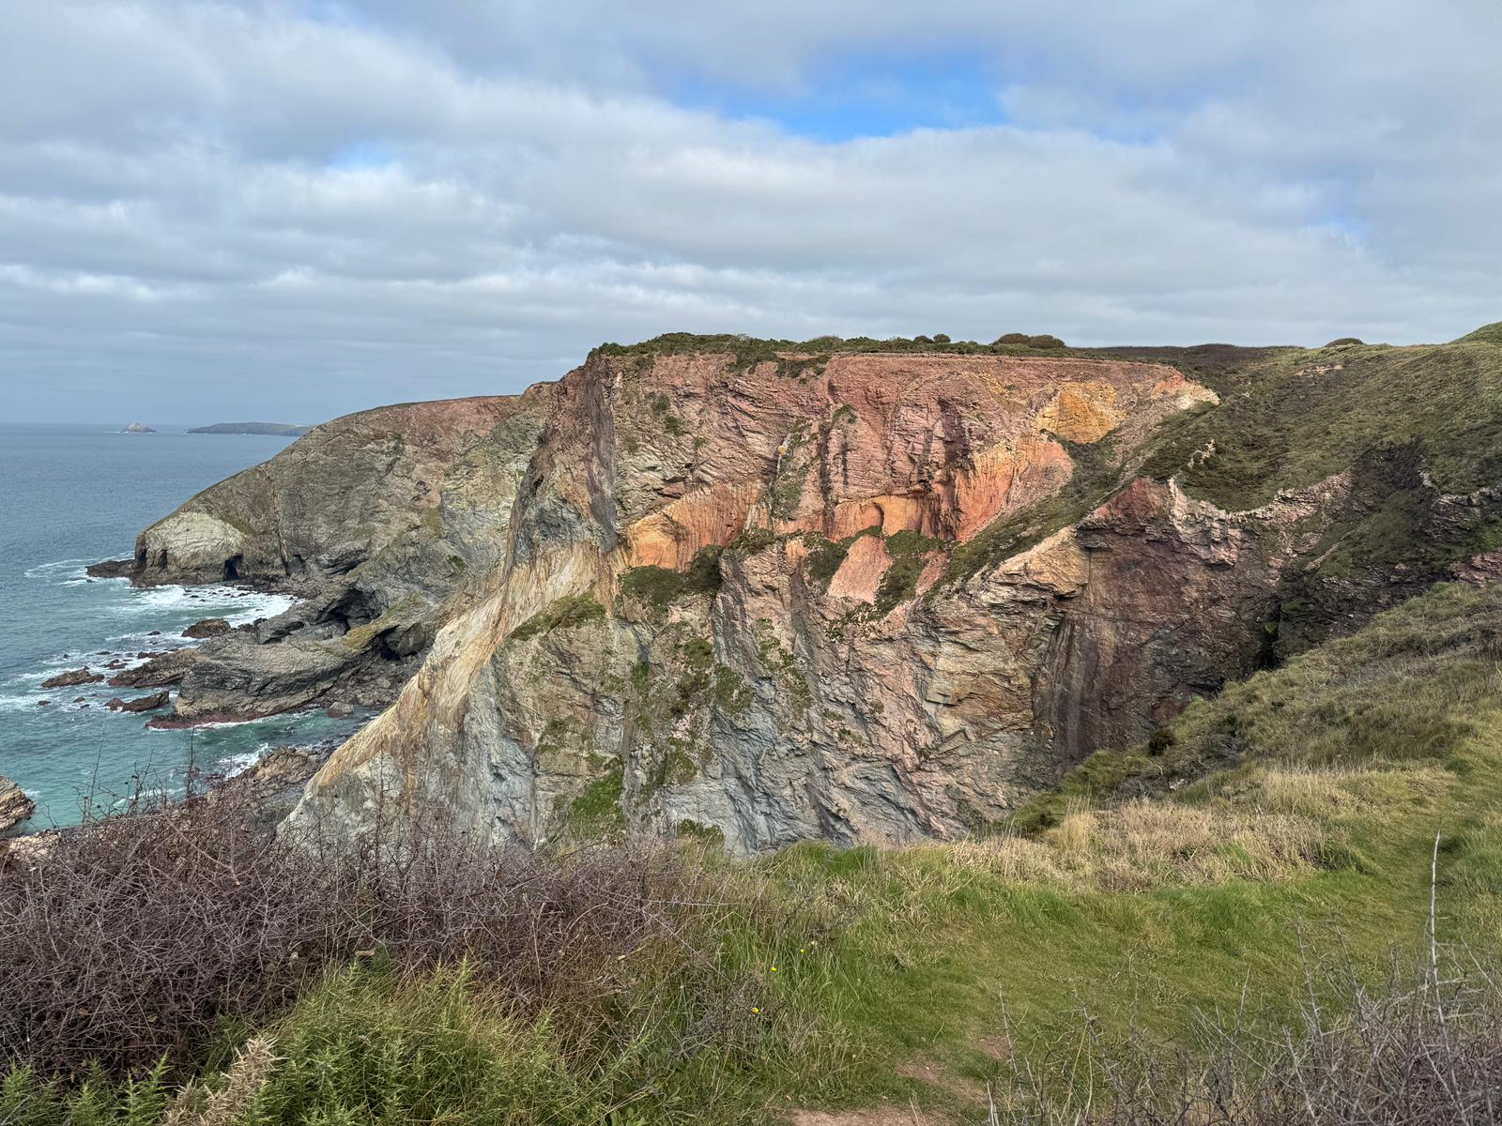
Day Three – Crantock Bay to Porthtowan
Ready to walk at 08:25
Coach leaves at 08:30
Mixture of beach, dunes and cliff top walking
Insight into mining history of the area
Highlights include
Perran Beach
St Agnes Head
Wheal Coates Mine
Chapel Porth
Finish at Unicorn Inn, Porthtowan
Coach leaves at 17:30 to return to Tregenna
Option | Start | Distance (miles)
Ultra | Crantock Bay | 16.5
Long | Holywell Bay | 12.5
Short | Perranporth | 8.5

Slide 12
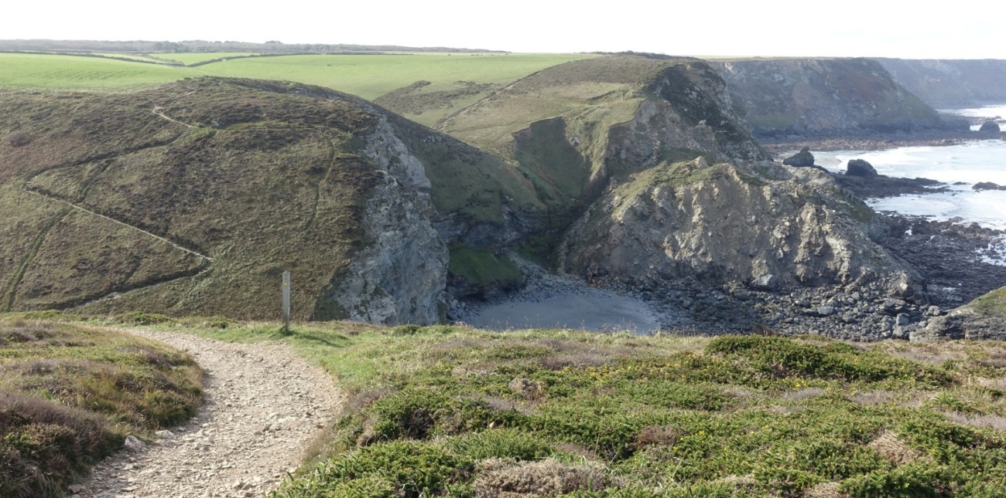
Day Four – Porthtowan to Hayle
Group photograph at 08:20
Ready to walk at 08:25
Coach leaves at 08:30
Climbs before and out of Portreath
Highlights include
Wheal Tye Mine
Coastal Views
Seals
Finish at Bluff Inn, Hayle
Coach leaves at 17:30 to return to Tregenna
Pay your bar bill before you go to bed!!
Option | Start | Distance (miles)
Ultra | Porthtowan | 14.5
Long | Portreath | 11
Short | Derrick Cove | 7.5

Slide 13
Day 5 – Walking + Travel
Pay your bar bill (if you haven’t already)
Checkout
What do I do with my suitcase?
Car travellers – load it into your car
Train travellers – load it onto the coach
Wear your T-shirt/polo
After the walk
Be ready to board a coach from Marazion at 13:30
One coach returns car travellers to the Tregenna
Another coach takes train travellers to St Erth in time for 14:24 train

Slide 14
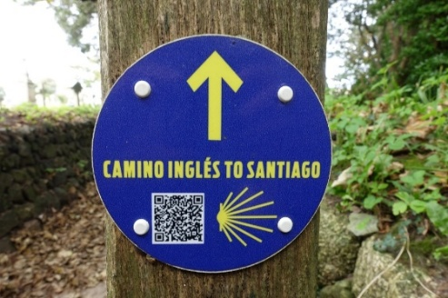
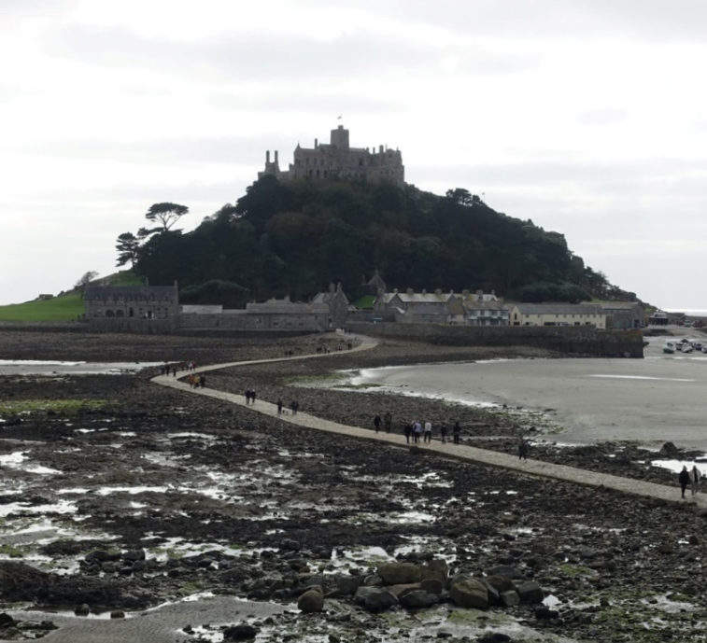
Day Five – St Ives to Marazion (St Michael’s Way)
Be ready to walk at 08:25
Long distance walkers walk from hotel
Short distance walkers – coach leaves at 08:30
Highlights include
Knill’s Monument
The Bowl Rock,
Ninnesbridge Primitive Methodist Chapel with the Celtic Cross,
St Michael’s Mount,
Finish at The Square, followed by Marazion Hotel garden (good weather)
Option | Start | Distance (miles)
Long | Tregenna | 8
Short | Trencom Hill | 4.5

Slide 15
Health & Safety
Designated first aiders
Glenn Connolly
Nikita Raval
Chris Hughes
Angela Harper
Emergency contact numbers will be distributed prior to the walk
Minibus
To transport walkers who need to drop out of the day’s walk due to injury or fatigue
If you need to drop out, please try to get to a checkpoint or at least a road if possible
Will be available for the entire walk until the sweepers have arrived at the end of day pub
what3words – https://what3words.com/
Free app used by emergency services to identify a location within a 3-metre square

Slide 16
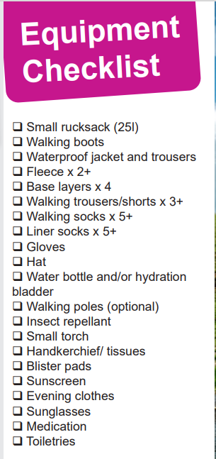
Equipment – What to pack?
Choosing the right kit will ensure that you are happy and comfortable during your challenge and can also help you avoid injury or soreness.
Clothing – the temperature is likely to still be cooler and changeable in May so bring plenty of layers and consider loose-layered clothing that permits free airflow. Good waterproofs will also be essential if we get caught in any showers. Synthetic-blend materials that wick away moisture and dry quickly can be useful if it is warmer or you get wet.
Small Rucksack (roughly 25 litre) – you will be carrying your water, packed lunch, sun cream, small first aid kit and spare layers etc. each day so try and get a rucksack with a back system, with reduced mesh panel for greater comfort, air circulation and heat dispersion.
Boots – walking boots should be comfy with ankle support and well worn in before the walk. Why not join us on our regular training walks to wear them in?
Carry a whistle
Cash – please bring some cash for tips for hotel staff and coach drivers

Slide 17
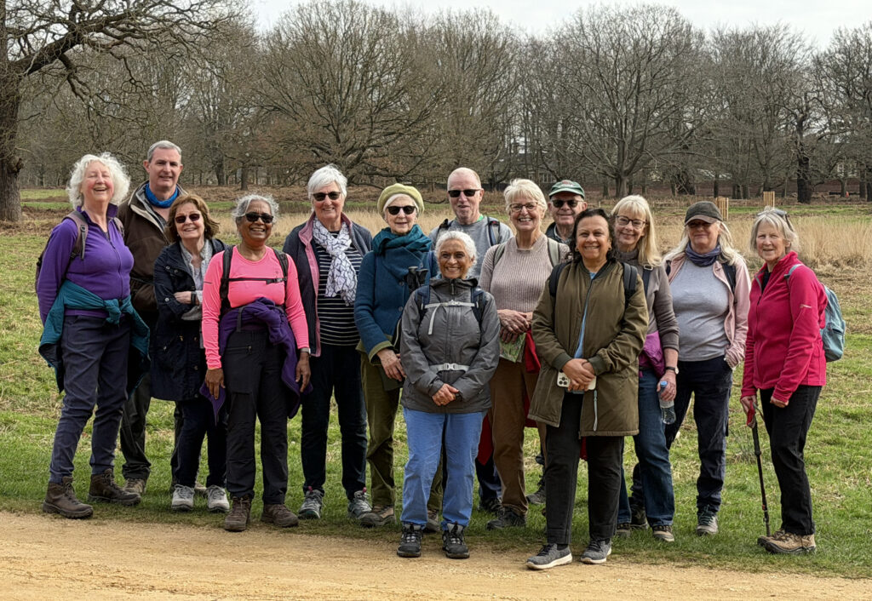
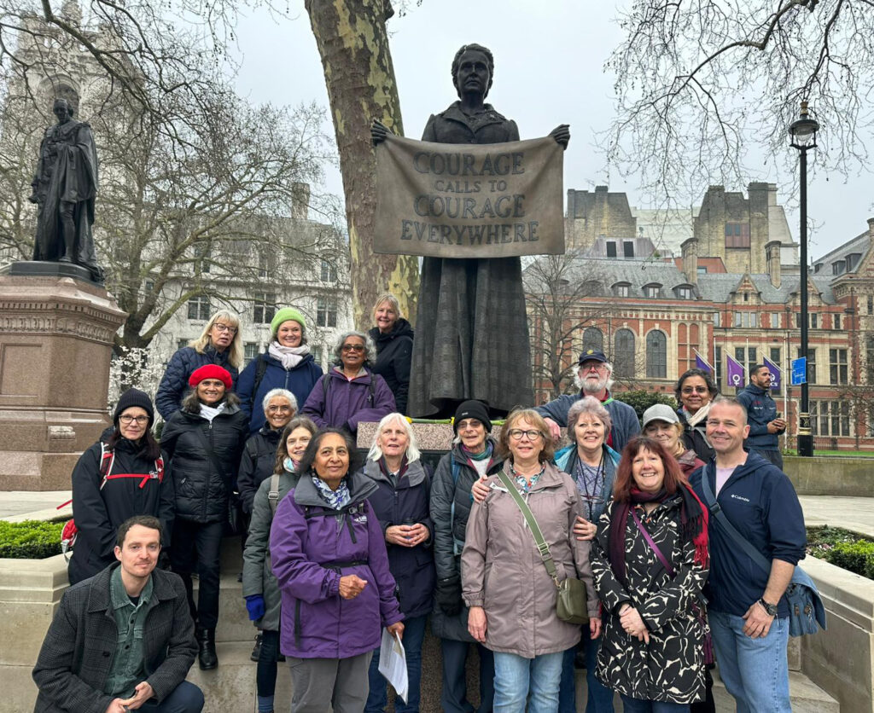
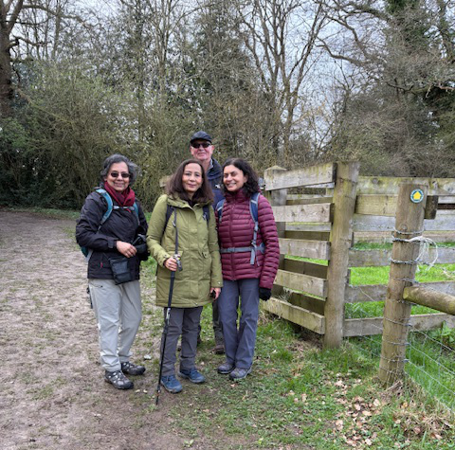
St Luke’s Walking Club
Coming soon
April 19: Saunderton via West Wycombe Circular -11 miles
April 25 Bucks Village Walk – Lane End – 11.5 miles
May 1 Ashridge Estate Circular to explore Best Bluebell Woods - 11.5 miles
May 3 Hampden Climber – 14 miles
May 5 Chesham Outer Ring – 8 miles
May 9 Amersham to Northwood Hills – 15 miles
May 12 Watford Metropolitan line station to
Berkhamsted Station – 11 miles
May 16 Christmas Common Circular – 15 miles
https://www.stlukeswalkingclub.org.uk
https://stlukeswalkingclub.org.uk

Slide 18
Fundraising
We'd love you to reach or exceed the £350 minimum sponsorship total!
£2.2M raised by the Annual Walk over the last 29 years, making an enormous impact on the patients and families of St Luke’s Hospice
St Luke's can only continue to provide support to our local community through the generosity of your support – thank you
Offline donations into the fundraising office by the end of July 2026

Slide 19


Tips for Your JustGiving or Enthuse Page
Online Donation Page – easiest way to collect donations, update your supporters and collect Gift Aid to increase your final total
Offline Donations – these can be made too
Profile photo - reassures your supporters that they are donating to the right page and keeps them interested
Explain your why - personalise your page by sharing your reason for taking part
Share your page – social media, emails, WhatsApp, company intranet, ask friends and family to reshare
Updates – add commentary and photos as you train and whilst taking part in the walk
Donations – donate to your own page; donors may be influenced by the most recent donation amount, so it is great to have a larger amount as your first donation
Company Match Funding - ask your company if they have a scheme
Final Update - this is a great way to thank your supporters again and give them the final figure you have raised

Slide 20
Get in touch with us for....
Help with your online pages
More sponsorship forms
Posters to promote your sponsored walk
Collection tins to put with a poster

Slide 21

Looking forward to celebrating
30 years of the Annual Walk
See you in Cornwall!

